Slide 1






Foundations of
Quantum Information Science (QIS 101)
Dave Biersach
Brookhaven National Laboratory
dbiersach@bnl.gov
Session 23
Quantum Circuits

Slide 2
Session 23 – Goals
Compare and contrast state transitions represented by real matrices (probabilities) vs. complex matrices (amplitudes)
Appreciate the crucial role of interference (phase cancellation) in the superposition of complex waves
Map Terry Rudolph's PETE box to the concept of superposition obtained by applying the Hadamard gate
Review IBM Qiskit and run it in a Jupyter notebook
Map the action of the CNOT, CCNOT, and CSWAP gates and understand how the support reversible computing
Represent gates via their action (operator) unitary matrices

Slide 3
Session 23 – Goals
Combine multiple inputs using the tensor product of matrices
Appreciate the limitations of the No Cloning Theorem
Derive the Bloch Sphere to represent qubit state
Appreciate the non-deterministic nature of qubits when superposition collapses due to measurement
Use Qiskit simulator to demonstrate entanglement as it relates to correlated qubits
Simulate classical Boolean logic using qubits

Slide 4
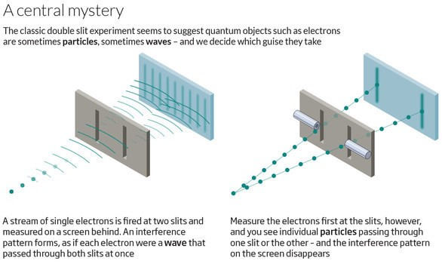
Quantum Double Slit Experiment

Slide 5
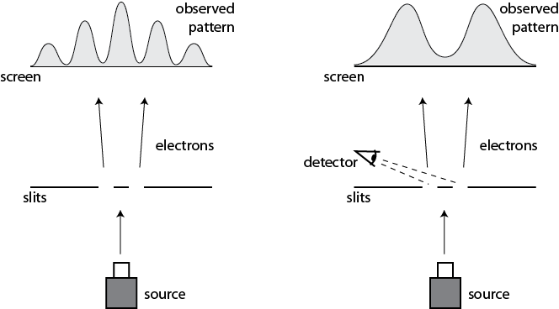
Quantum Double Slit Experiment
This happens even if we only allow a single electron at a time to pass through the slits

Slide 6
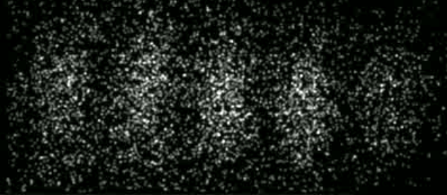
Quantum Double Slit Experiment
Time-Lapse Photograph of Single Electron Double-Slit Interference Pattern
In 1965, Richard Feynman called this the
"central mystery" of quantum theory, and then corrected himself, saying that in fact
"it is the only mystery"
Herman Batelaan, University of Nebraska-Lincoln, 2013

Slide 7
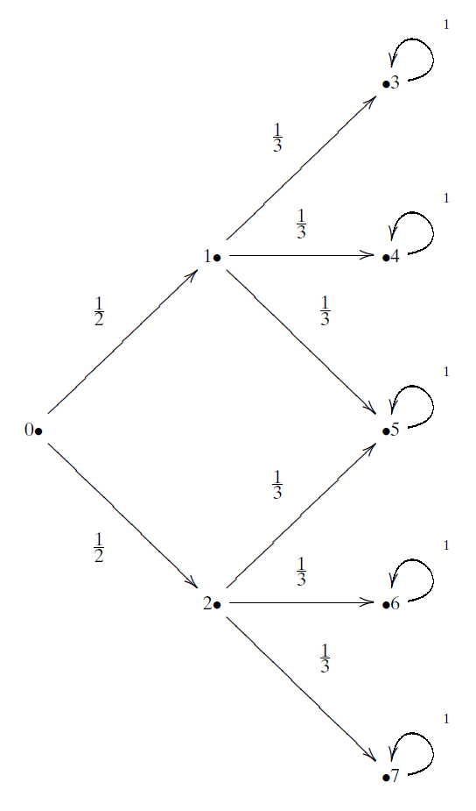
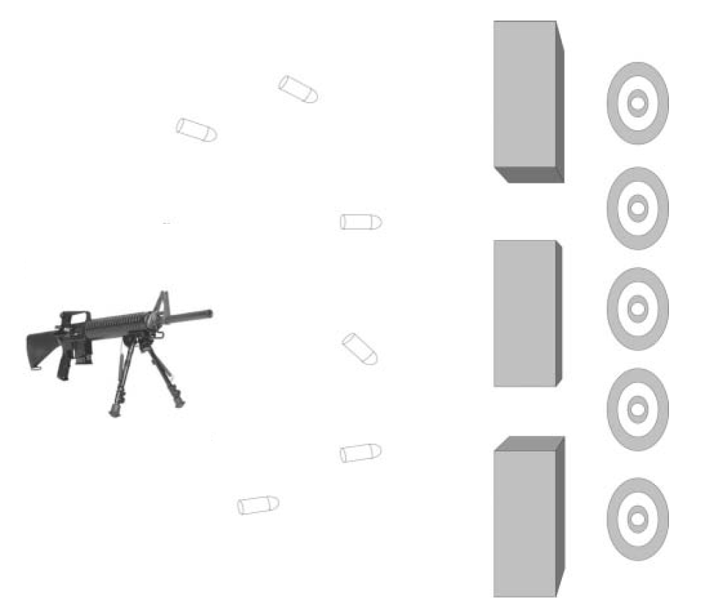
The Double Slit Experiment as a Matrix
Bullets
(Particles)
Transition Probability

Slide 8
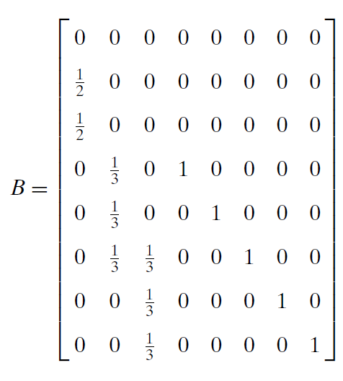
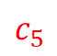
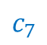
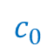
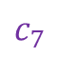
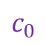
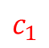
The Double Slit Experiment as a Matrix
FROM
$$c_{0}$$
$$c_{1}$$
$$c_{7}$$
$$c_{0}$$
TO
$$c_{5}$$
$$c_{7}$$
Bullet
Transition Probabilities For One Time Step

Slide 9
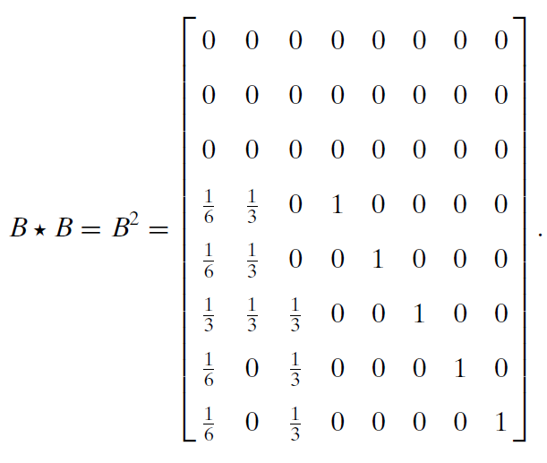
The Double Slit Experiment as a Matrix
Every time we multiple a transition matrix by itself,
we can calculate another time step (the next transition matrix)
Bullet
Transition Probabilities For
One Time Step
Bullet
Transition Probabilities After
Two Time Steps

Slide 10
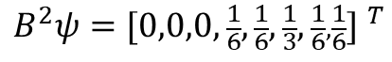
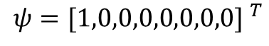
The Double Slit Experiment as a Matrix
Bullet Location Probabilities After Two Time Steps
$$ψ={[1,0,0,0,0,0,0,0] }^{T}$$
$$B^{2}ψ={[0,0,0,\frac{1}{6},\frac{1}{6},\frac{1}{3},\frac{1}{6},\frac{1}{6}] }^{T}$$

Slide 11
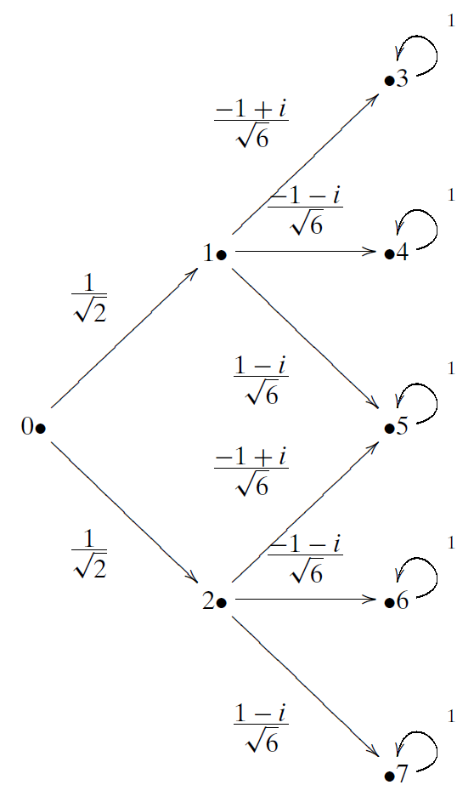
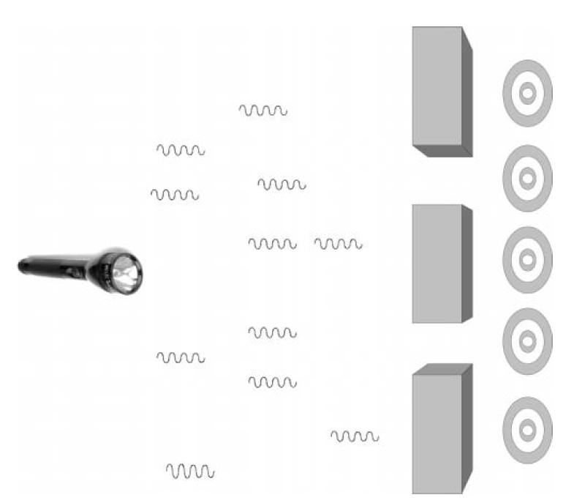
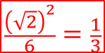
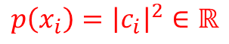
The Quantum Double Slit as a Matrix
Transition Amplitude
Photons
$$\frac{{\left(\sqrt{2}\right)}^{2}}{6}=\frac{1}{3}$$
$$\frac{1}{2}$$
When we square the norm of a transition amplitude, we get the transition probability
$$p\left(x_{i}\right)={\left|c_{i}\right|}^{2}∈ℝ$$

Slide 12
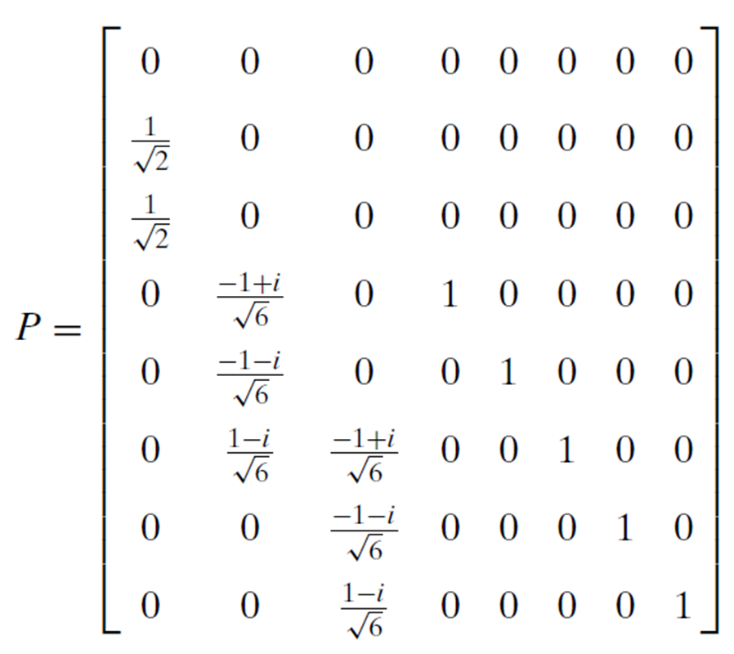
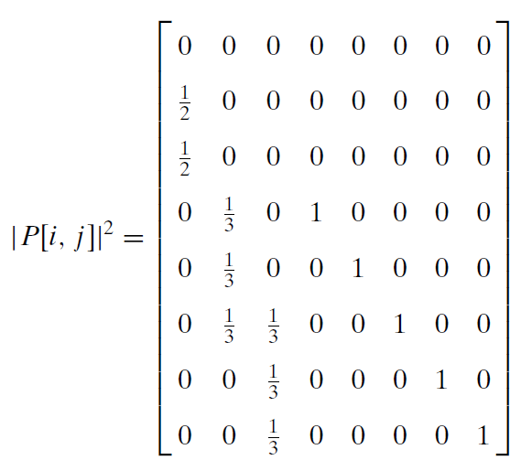
The Quantum Double Slit as a Matrix
When we measure a photon, its wave function collapses, and the norm squared of each amplitude becomes a probability
Photon
Transition Amplitudes For
One Time Step
Photon
Transition Probabilities For
One Time Step

Slide 13

The Quantum Double Slit as a Matrix
Once we measure the photon,
it starts to act like a bullet (a particle)…
$$=$$
Photon
Transition Probabilities For
One Time Step
Bullet
Transition Probabilities For
One Time Step

Slide 14
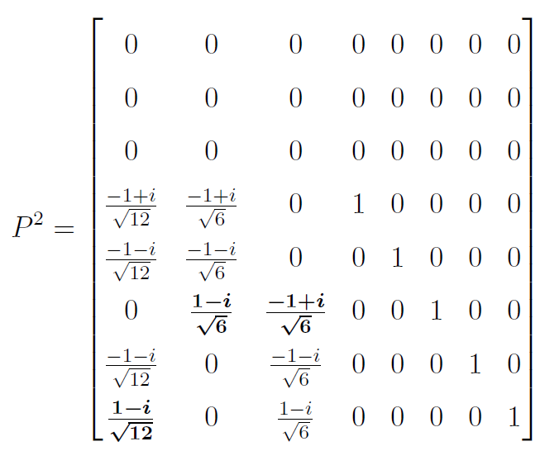

The Quantum Double Slit as a Matrix
If we do not measure the photon, we continue to use its transition amplitudes to calculate the next step…
$$P∙P$$
Photon
Transition Amplitudes For
One Time Step
Photon
Transition Amplitudes For
Two Time Steps

Slide 15
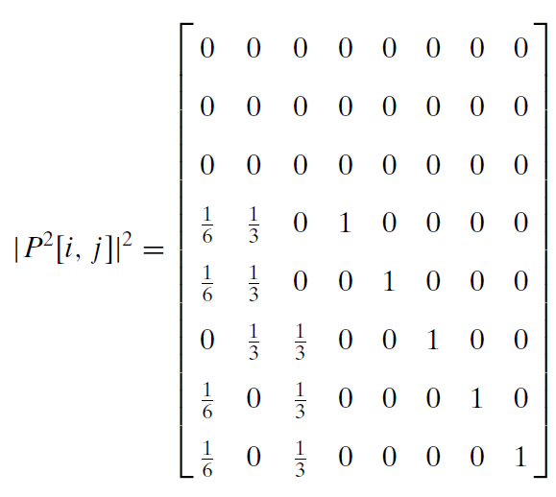
The Quantum Double Slit as a Matrix
If we measure the photon after the first step:
If we measure the photon only after the second step:
Photon
Transition Probabilities For
One Time Step
Photon
Transition Probabilities For
Two Time Steps

Slide 16

The Quantum Double Slit as a Matrix
If we wait to measure the photon only after two steps, we see it is acting like a wave (not like a particle)…
$$≠$$
Bullet
Transition Probabilities For
Two Time Steps
Photon
Transition Probabilities For
Two Time Steps

Slide 17
The Quantum Double Slit as a Matrix
Photons
Photon
Transition Probabilities For
Two Time Steps
The complex amplitudes in the photon's operator cause destructive interference

Slide 18


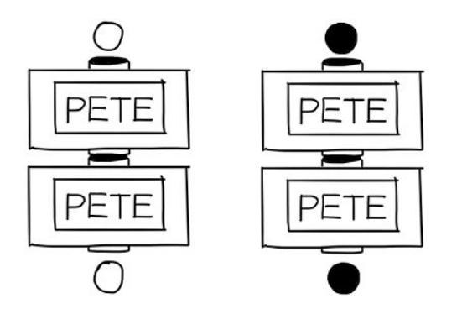
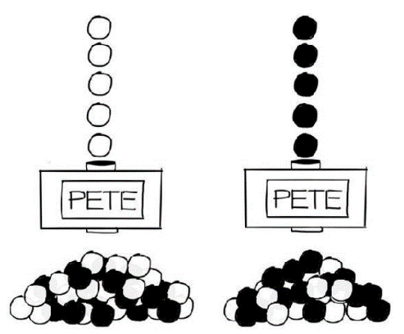
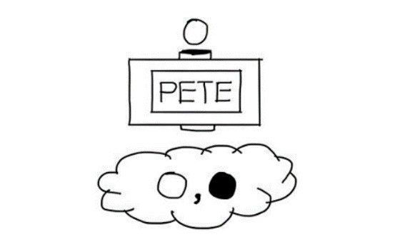
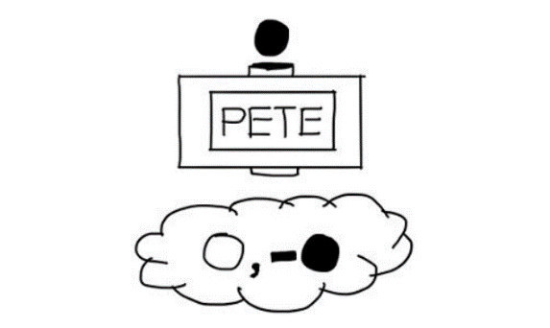
A Useful Introductory Metaphor
Terry Rudolph - Q is for Quantum
How is it always the same?
What about the 50/50?
A Quantum Gate
50/50 – no way to force it
"Misty" State
Be mindful of the negative sign!

Slide 19
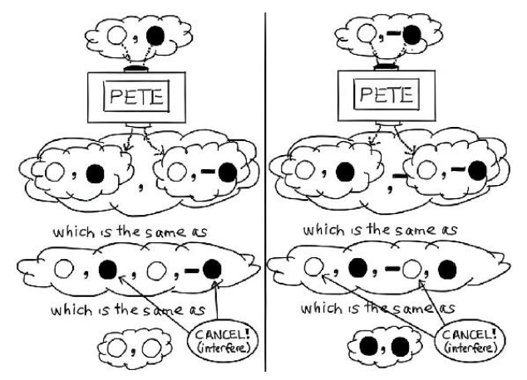
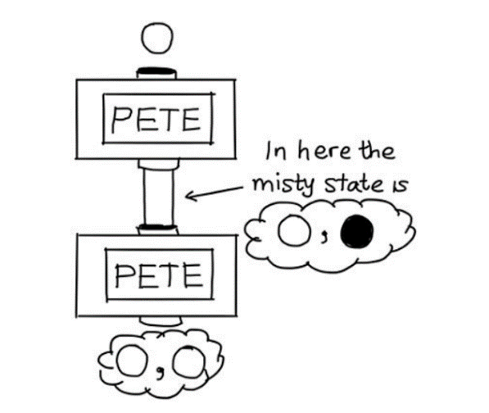
A Useful Introductory Metaphor
Terry Rudolph - Q is for Quantum

Slide 20
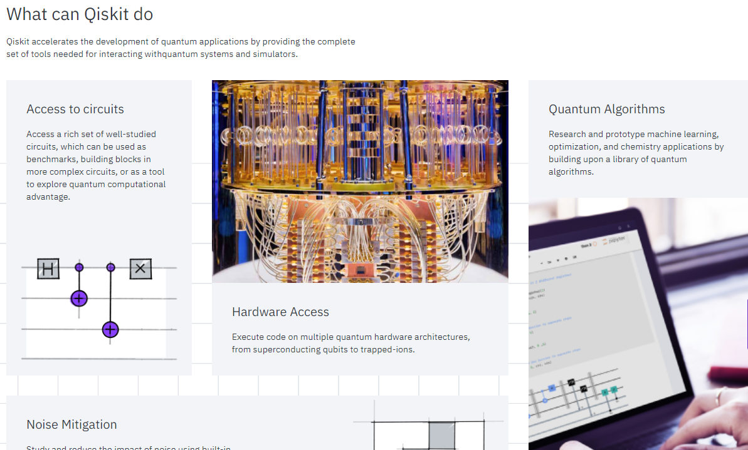
IBM Qiskit
https://qiskit.org

Slide 21
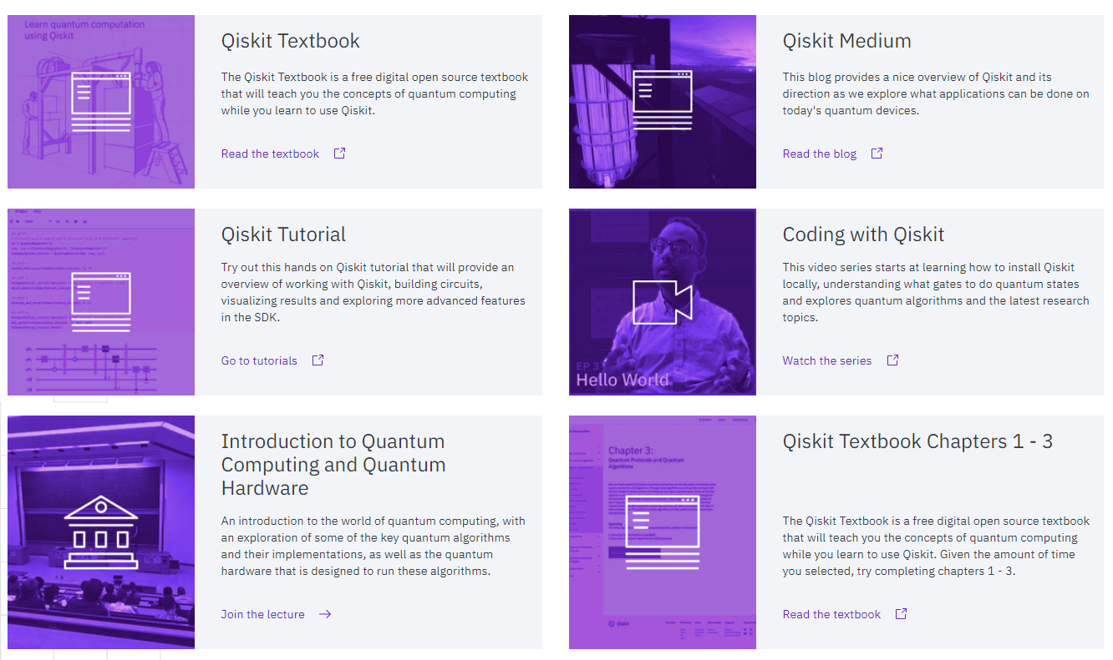
IBM Qiskit
https://qiskit.org/learn

Slide 22
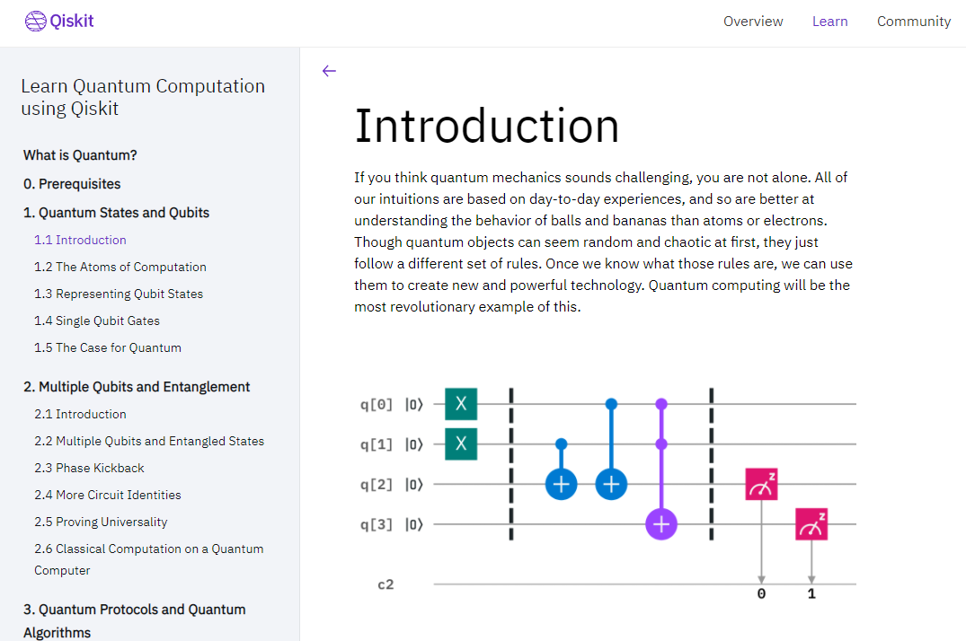
IBM Qiskit
https://qiskit.org/textbook

Slide 23
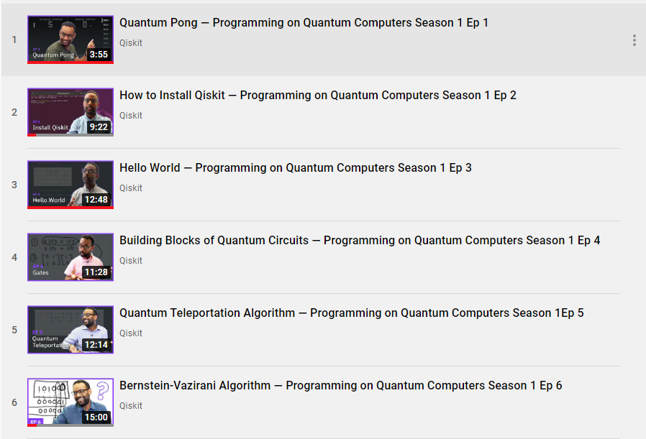
IBM Qiskit
Qiskit Foundations - Coding With Qiskit - Season 1

Slide 24
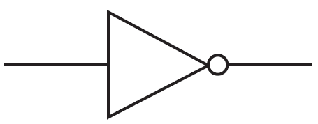
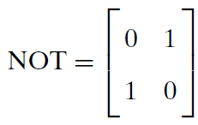
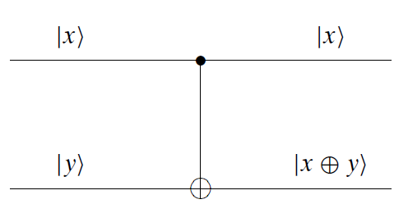
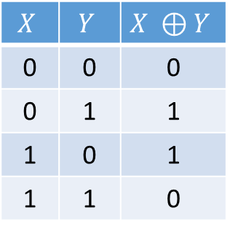
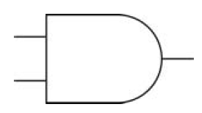
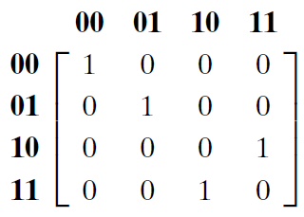
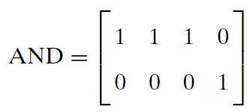
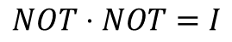
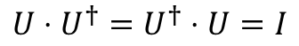
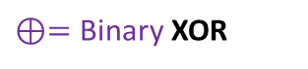
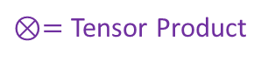
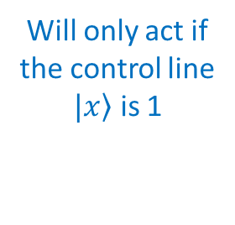
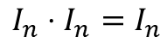
Quantum Gates
In the quantum world, all operations that are not measurements must be reversible and must be represented by unitary matrices
$$U⋅U^{†}=U^{†}⋅U=I$$
$$I_{n}⋅I_{n}=I_{n}$$
Controlled NOT (CNOT)
$⊗=$ Tensor Product
Control Line
$$NOT⋅NOT=I$$
$⊕=$ Binary XOR
Yes
x y
in
out
x y
Will only act if the control line
$\left.|x\right\rangle$ is 1
CNOT is both reversible and universal
No

Slide 25
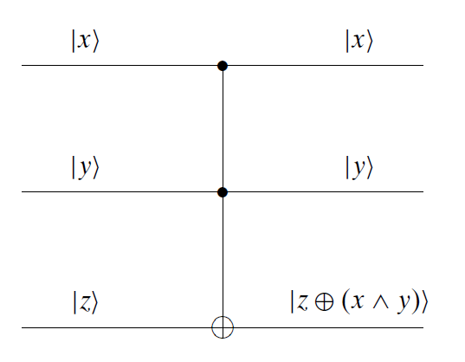
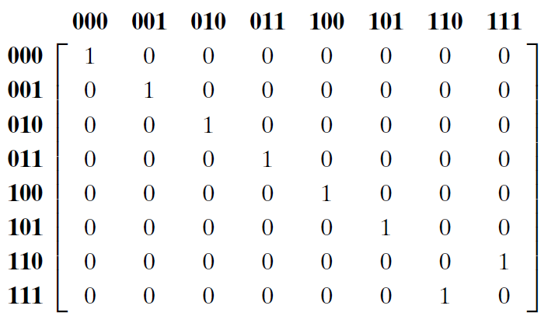
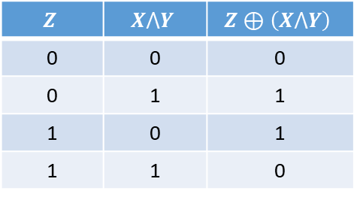
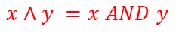

Quantum Gates
Like the NAND and NOR gates, the CCNOT is
a universal gate for Boolean logic
Controlled Controlled NOT (CCNOT)
x y z
in
Control Line 1
out
Control Line 2
$$x∧y =x AND y$$
Only acts if both controls $\left.|x\right\rangle$and $\left.|y\right\rangle$are 1
CCNOT is reversible
$$Z$$ | $$X⋀Y$$ | $$Z⊕\left(X⋀Y\right)$$
0 | 0 | 0
0 | 1 | 1
1 | 0 | 1
1 | 1 | 0
A Toffoli Gate

Slide 26



Quantum Gates
Controlled Swap (CSWAP)
x y z
in
Control Line
out
If control $\left.|x\right\rangle$ is 1,
$\left.|y\right\rangle$ and $\left.|z\right\rangle$ values are swapped
CSWAP is reversible
The CSWAP is
a universal gate for Boolean logic
A Fredkin Gate

Slide 27





Unitary Matrices
$$\frac{1}{\sqrt{2}}\left[\begin{matrix}1 & 1 \\ 1 & −1\end{matrix}\right]=H$$
$${\left(\frac{1}{\sqrt{2}}\left[\begin{matrix}1 & 1 \\ 1 & −1\end{matrix}\right]\right)}^{2}=\frac{1}{2}\left[\begin{matrix}2 & 0 \\ 0 & 2\end{matrix}\right]=I$$
Hadamard Gate
Hadamard Matrix is Unitary
0
$$\frac{1}{\sqrt{2}}\left[\begin{matrix}1 & 1 \\ 1 & −1\end{matrix}\right]\left[\begin{matrix}1 \\ 0\end{matrix}\right]=\frac{1}{\sqrt{2}}\left[\begin{matrix}1 \\ 1\end{matrix}\right]=\frac{\left.\left|0\right.\right\rangle +\left.\left|1\right.\right\rangle }{\sqrt{2}}$$
Hadamard puts a qubit into a superposition of states, with a 50/50 chance of getting a 0 or 1
1
$$\frac{1}{\sqrt{2}}\left[\begin{matrix}1 & 1 \\ 1 & −1\end{matrix}\right]\left[\begin{matrix}0 \\ 1\end{matrix}\right]=\frac{1}{\sqrt{2}}\left[\begin{matrix}1 \\ −1\end{matrix}\right]=\frac{\left.\left|0\right.\right\rangle −\left.\left|1\right.\right\rangle }{\sqrt{2}}$$
$${\left(\frac{1}{\sqrt{2}}\right)}^{2}=\frac{1}{2}=50\%$$
Note: these are not the same states, yet they have the same expectation values (probabilities)

Slide 28






Unitary Matrices
Here are some additional fundamental unitary matrices that can act on qubits:
$$X$$
$$Y$$

Slide 29


Unitary Matrices
Gates like CNOT and CCNOT are made by combining the quantum unitary matrices like X, Y, Z, S, T, and H

Slide 30



Unitary Matrices
We can create a SWAP gate using
three CNOT gates or six Hadamard Gates

Slide 31

Unitary Matrices

Slide 32

Unitary Matrices

Slide 33


Amplitude vs. Probability
Addition is Commutative, Subtraction is NOT
Note: these are not the same states, yet they have the same expectation values (probabilities)

Slide 34







Amplitude vs. Probability
$$\sqrt{NOT}$$
$$\sqrt{NOT}$$
But are these two "zeros" the same state?
Scalar multiplication of $\left.\left|ψ\right.\right\rangle$ does not change the probabilities
$$\left.\left(s\right)\left|ψ\right.\right\rangle ⟼p\left(x_{i}\right)$$
Refer to these:
Session 14 - Slide 38
Session 22 - Slide 42

Slide 35

Representing Multiple Qubits
$${\left[\begin{matrix}0 \\ 1\end{matrix}\right]}^{⨂3}=\left[\begin{matrix}0 \\ 1\end{matrix}\right]⨂\left[\begin{matrix}0 \\ 1\end{matrix}\right]⨂\left[\begin{matrix}0 \\ 1\end{matrix}\right]$$
$$=\left[\begin{matrix}0 \\ 1\end{matrix}\right]⨂\left[\begin{matrix}\left(0\right)\left[\begin{matrix}0 \\ 1\end{matrix}\right] \\ \left(1\right)\left[\begin{matrix}0 \\ 1\end{matrix}\right]\end{matrix}\right]=\left[\begin{matrix}0 \\ 1\end{matrix}\right]⨂\left[\begin{matrix}0 \\ 0 \\ 0 \\ 1\end{matrix}\right]$$
0
$$=\left[\begin{matrix}\left(0\right)\left[\begin{matrix}0 \\ 0 \\ 0 \\ 1\end{matrix}\right] \\ \left(1\right)\left[\begin{matrix}0 \\ 0 \\ 0 \\ 1\end{matrix}\right]\end{matrix}\right]=\left[\begin{matrix}0 \\ 0 \\ 0 \\ 0 \\ 0 \\ 0 \\ 0 \\ 1\end{matrix}\right]=\left|\left.111\right\rangle \right.$$
$${111}_{2}=7_{10}$$
7

Slide 36









Representing Multiple Qubits
A qubyte
$${\left(ℂ^{2}\right)}^{⊗8}=ℂ^{256}$$
0
107
255

Slide 37







Run Cells 1 to 7 – quantum_gates.ipynb
Demonstrate the following seven identities by applying the operator matrix for quantum gate
$$\#1) X^{2}=Y^{2}=Z^{2}=I$$
$$\#5) −1Y=HYH$$
$$\#2) H=\frac{1}{\sqrt{2}}(X+Z)$$
$$\#6) {S=T}^{2}$$
$$\#3) X=HZH$$
$$\#7) −1Y=XYX$$
$$\#4) Z=HXH$$

Slide 38


Run Cell 1 quantum_gates.ipynb
①
②
③
④
⑤
⑥
⑦
⑧

Slide 39






Run Cells 2 to 4 – quantum_gates.ipynb

Slide 40






Run Cells 5 to 7 – quantum_gates.ipynb

Slide 41


No Cloning Theorem
Can we send the same input qubit to two different output lines?
Controlled Swap (CSWAP)
Controlled Controlled NOT (CCNOT)
A NOT symbol
Can we use a CSWAP to produce a fanout?
Can we use a CCNOT to produce a fanout?
A Fredkin Gate
A Toffoli Gate

Slide 42










No Cloning Theorem
"We can cut-n-paste, but not copy-n-paste"
$$\left.\left|x\right.\right\rangle =\frac{\left.\left|0\right.\right\rangle +\left.\left|1\right.\right\rangle }{\sqrt{2}}=\left[\begin{matrix}\frac{1}{\sqrt{2}} \\ \frac{1}{\sqrt{2}}\end{matrix}\right]$$
$x$ is in superposition
$$x=0/1,y=1, z=0$$
$$y$$
$$z$$
in
out
in
$$\frac{\left|\left.0,1,0\right\rangle \right.+\left|\left.1,1,0\right\rangle \right.}{\sqrt{2}}$$
out
$$\frac{\left|\left.0,1,0\right\rangle \right.+\left|\left.1,0,1\right\rangle \right.}{\sqrt{2}}$$
The output state is not an exact copy of the input state

Slide 43

No Cloning Theorem
Show how the CCNOT gate shown on slide #37 cannot exactly clone this input state: $x=\left|\left.1\right\rangle \right.$, $z=\left|\left.0\right\rangle \right.$, and $y$ is a 50/50 superposition:
$$\frac{\left|\left.1,0,0\right\rangle \right.+\left|\left.1,1,0\right\rangle \right.}{\sqrt{2}}$$
The no cloning theorem says you cannot clone an arbitrary state (e.g., all possible states) but you might be able to clone a single specific state

Slide 44
The Bloch Sphere
How can we visually represent a qubit on a printed page using only black & white ink?
$$\left.\left|ψ\right.\right\rangle =(a+bi)\left.\left|0\right.\right\rangle +(c+di)\left.\left|1\right.\right\rangle$$
It appears we must be able to plot four independent parameters: $\left(a,b,c,d\right)∈ℝ$
Therefore, we have a 4D object to visualize,
but we only have a 2D plane upon which we can draw
We cannot use the trick of indicating the 4th dimensional parameter using color in an oblique projection of a 3D surface

Slide 45








The Bloch Sphere
A complex number with a unit modulus is a point on a unit circle
Felix Bloch
(1905-1983)
Killing the phase of $\left.\left|0\right.\right\rangle$
$$φ=φ_{1}−φ_{0}$$
$$φ_{0}→0$$
Only two real parameters remain: $θ$ and $φ$

Slide 46




The Bloch Sphere
$$φ=φ_{1}−φ_{0}$$
A qubit at the equator has a 50/50 chance of collapsing to either $\left.\left|0\right.\right\rangle$ or $\left.\left|1\right.\right\rangle$
Changing the phase $φ$ does not affect the probability of the state to which it will collapse: $\left.\left|0\right.\right\rangle$ or $\left.\left|1\right.\right\rangle$
Every unitary 2x2 operator (a quantum gate) will manipulate the sphere in some way

Slide 47




The Bloch Sphere

Slide 48

Quantum Superposition
Things are simple enough for an individual qubit:
$$\left|\left.ψ\right\rangle =c_{0}\left|\left.0\right\rangle \right.+c_{1}\left|\left.1\right\rangle \right.\right.$$
The picture is more difficult for a quantum register containing many qubits:
$$\left|\left.ψ\right\rangle =c_{0}\left|\left.00\right\rangle \right.+c_{1}\left|0\left.1\right\rangle \right.\right.+c_{2}\left|\left.10\right\rangle \right.+c_{3}\left|1\left.1\right\rangle \right.$$
Superposition doesn't mean the qubit is simultaneously assuming all possible values at every instant – it has a singular definite value at any moment - but we cannot know that value (when we measure it becomes 0 or 1 only)
Superposition is not entanglement – an isolated qubit in superposition does not affect other qubits

Slide 49


Run Cell 1 superposition
①
②
③
④
⑤

Slide 50




Run Cell 2 – superposition
sv1
sv2
①
②
③
④
⑤
⑥
⑦
⑧
⑨
⑩

Slide 51





Run Cell 3 – superposition
sv1
sv2
①
②
③
④
Note: Without any measurements,
the histogram is based solely on the final state vector (amplitudes² = probabilities)

Slide 52



Run Cell 4 – superposition
①
②
③
④
Using more (measured) shots brings us closer to the expected outcomes
$$p\left(\left|\left.0\right\rangle \right.\right)={\left(\frac{\sqrt{3}}{2}\right)}^{2}=\frac{3}{4}=0.75$$
$$p\left(\left|\left.1\right\rangle \right.\right)={\left(\frac{1}{2}\right)}^{2}=\frac{1}{4}=0.25$$

Slide 53


Run Cell 5 – superposition
①
Using 10,000 shots brings us closer to the expected outcomes (Monte Carlo method)
$$p\left(\left|\left.0\right\rangle \right.\right)={\left(\frac{\sqrt{3}}{2}\right)}^{2}=\frac{3}{4}=0.75$$
$$p\left(\left|\left.1\right\rangle \right.\right)={\left(\frac{1}{2}\right)}^{2}=\frac{1}{4}=0.25$$

Slide 54






Run Cell 6 – superposition
①
②
③
④
Phase doesn't change the probability of ultimately measuring a $\left|\left.0\right\rangle \right.$ or a $\left|\left.1\right\rangle \right.$
In the final state vector, it is still 50/50

Slide 55





Run Cell 7 – superposition
①
②
③

Slide 56






Run Cell 8 – superposition
sv1
sv2
sv3
sv4
①
②
$$X\left(\left|\left.1\right\rangle \right.\right)=\left|\left.0\right\rangle \right.$$
③

Slide 57

Quantum Entanglement
An important distinguishing feature between qubits and classical bits is that multiple qubits can exhibit quantum entanglement
Quantum entanglement is a nonlocal property of two or more qubits that allows a set of qubits to express higher correlation than is possible in classical systems
Controlled gates (CNOT, CCNOT, CSWAP, etc.) can entangle qubits that are in superposition – if you measure one, the other entangled qubits instantly assume a given value – no matter how far apart the qubits may physically reside

Slide 58

Quantum Entanglement
In IBM Qiskit, quantum states follow this convention:
$$\left|\left.MSB,⋯,LSB\right\rangle \right.$$
This means the most significant bit (MSB) of the decimal index number of an amplitude appears first, and the least significant bit (LSB) comes before the right-angle bracket:
Qiskit way: $\left|\left.z,y,x\right\rangle \right.$ vs. Physicists way: $\left|\left.x,y,z\right\rangle \right.$
This is a backwards ordering scheme compared to the approach shown on slides # 24 - # 39, but it does follow how we tend to express binary numbers (left to right):
$$c_{6}\left|\left.1,1,0\right\rangle \right.≡Amplitude of state 6→{110}_{2}=6_{10}$$

Slide 59









Run Cell 1 entanglement
①
②
Both qubits are initialized to the $\left|\left.0\right\rangle \right.$ state
③
④
⑤
$$\left|\left.q_{1}q_{0}\right\rangle \right.$$
$$\left|\left.q_{1}q_{0}\right\rangle \right.$$
$q_{0}$ is in a 50/50 superpostion

Slide 60




Run Cell 1 entanglement
①
Initial $ψ$
②
Both qubits are initialized to the $\left|\left.0\right\rangle \right.$ state
③
Final $ψ$
④
⑤
0 1 2 3
$$\left|\left.q_{1}q_{0}\right\rangle \right.$$
$$\left|\left.q_{1}q_{0}\right\rangle \right.$$
$q_{0}$ is in a 50/50 superposition

Slide 61






Run Cell 2 entanglement
①
Initial $ψ$
cx(q0, q1) =
Controlled (by q0) NOT (on q1)
②
③
Final $ψ$
0 1 2 3
$$\left|\left.q_{1}q_{0}\right\rangle \right.$$
④
⑤
$$\left|\left.q_{1}q_{0}\right\rangle \right.$$

Slide 62



Run Cell 3 entanglement
①
③
②
$$p\left(\left|\left.00\right\rangle \right.\right)={\left(\frac{1}{\sqrt{2}}\right)}^{2}=\frac{1}{2}=0.50$$
$$p\left(\left|\left.11\right\rangle \right.\right)={\left(\frac{1}{\sqrt{2}}\right)}^{2}=\frac{1}{2}=0.50$$

Slide 63

Quantum Entanglement
A natural question is this: If a single shot gives us exactly the expected results, and taking multiple shots results in a histogram that deviates away from the exact results, why would we ever use multiple shots?
The answer is we are creating very small circuits, whose state vector has a small number of amplitudes
A quantum circuit having 45 qubits would require a state vector with $2^{40}$ amplitudes ($×2$ to hold the both the real and imaginary components $×8$ bytes for 64-bit precision of both components) $=563 TB of RAM$ – currently the maximum RAM in Linux is $256 TB$
We cannot perfectly store such a large state vector, but we can execute the circuit thousands of times, measure the result of each shot, and tally the outcomes to create a histogram

Slide 64





Run Cell 4 entanglement
①
②
③
④
sv1
sv2
sv3
$$\left|\left.q_{2}q_{1}q_{0}\right\rangle \right.$$
$q_{0}$ and $q_{0}$are in independent 50/50 superpositions

Slide 65



Run Cell 5 entanglement
①
②
③
Using more shots brings us closer to the expected outcomes

Slide 66




Run Cell 6 entanglement
①
0
000
4
100
cx(q0, q2) =
Controlled (by q0) NOT (on q2)
3
011
②
7
111
③
SWAP
0 1 2 3 4 5 6 7

Slide 67
Run Cell 6 entanglement
0 1 2 3 4 5 6 7

Slide 68



Run Cell 7 entanglement
①
0
000
4
100
3
011
7
111
0 1 2 3 4 5 6 7

Slide 69




Run Cell 8 entanglement
①
"All or nothing"
$$\frac{\left|\left.000\right\rangle \right.+\left|\left.111\right\rangle \right.}{\sqrt{2}}$$

Slide 70




Run Cell 9 entanglement
①
0 1 2 3 4 5 6 7
1 2 4
"Mutually Exclusive"
$$\frac{\left|\left.001\right\rangle \right.+\left|\left.010\right\rangle \right.+\left|\left.100\right\rangle \right.}{\sqrt{3}}$$

Slide 71
Quantum Simulating Classical
All classical digital logic (Boolean) gates can be simulated using quantum gates
Quantum gates represent operators, and quantum operators can be represented as unitary matrices
Quantum computation must be reversible therefore ancilla bits may be required to allow unambiguous reconstruction of the initial input state
Time reversible algorithms require zero net energy to compute but not to "host" – consider the chillers required to keep current quantum circuits near absolute zero (20 millikelvin)

Slide 72






Run Cell 1 boolean_gates
①
Both qubits are set to the $\left|\left.1\right\rangle \right.$ state
②
③
④
ccx(q0, q1, q2) =
Controlled (by q0)
Controlled (by q1) NOT (on q2)
⑤
⑥
1
CCNOT
1
1
1
1
1

Slide 73




Run Cell 2 boolean_gates
①
②
Uncomment these lines to test the output based upon input permutations
All classical (Boolean) logic gates can be constructed from quantum gates
0
CCNOT
0
0
0
0
0

Slide 74





Run Cell 3 – boolean_gates
①
②
Full Adder
③

Slide 75



Run Cell 4 – Boolean_gates
①
④
Full Adder
⑤
⑥
⑦
②
③

Slide 76

CNOT Gate – Physical Implementation

Slide 77
Session 23 – Now You Know…
Due to the cancelling effects of complex amplitudes, wavefunctions can exhibit destructive interference
Each qubit we track in a circuit exponentially increases the output vector space due to the tensor multiplication
Quantum gates can be represented by unitary matrices as all computation effects must be reversible
Toffoli (CCNOT) and Fredkin (CSWAP) are universal gates
The No Cloning Theorem prevents the direct exact copy of any qubit – but we can "copy" the probabilities of reading a qubit's values (just not both the probability and the phase)

Slide 78
Session 23 – Now You Know…
IBM Qiskit is a premier development toolkit for writing quantum computer algorithms in Python
You can experiment with the Qiskit libraries within interactive Jupyter notebooks by executing cells of code
Most toy abstractions (like PETE boxes) are an attempt to avoid using complex numbers and Euler's formula for imaginary exponentials - do not fear linear algebra
Quantum algorithms cleverly manipulate the phase of qubits in a register to shape probabilities in their favor
Many quantum algorithms offer significant speed-up over their classical counterparts and new discoveries are being made every day – it is your generation's new frontier!

Slide 79

Task 23-01 Part A
Edit quantum_circuit1.ipynb to code the circuit below by applying the correct IBM Qiskit quantum gate before each of the four calls to qc.save_statevector():
Email your working Python program to your TA
sv1
sv2
sv3
sv4

Slide 80
Task 23-01 Part B
After implementing the circuit in Task 23-01 Part A, answer the following two questions in a short email to your TA:
Using the truth table below as a reference, explain the results depicted in state vector 4:
Explain the counts histogram after 10,000 shots: Why is there a 100% chance of measuring only a value of 0 for the single classical bit?

Slide 81
Task 23-02
Create a new Jupyter Lab notebook called quantum_circuit2.ipynb to implement and display an IBM Qiskit circuit that after 10,000 shots renders a histogram showing a 50/50 probability of generating bitstreams representing either the decimal numbers 63 or 64
Email your working Python program to your TA

Slide 82

Task 23-03 Part A
Create a new Jupyter Lab notebook called quantum_circuit3.ipynb to implement and display this IBM Qiskit circuit, and display the histogram after 100,000 shots
Email your working Python program to your TA

Slide 83

Task 23-03 Part B
In a short email to your TA, explain why the probability of measuring a value of 1 for q6 is 0.0625
Note: the histogram only displays the value of 0.062 but the actual probability is 0.0625

